Slide 1
E-Commerce Capastone Project
Market Mix Modelling
Submitted by : NagaChaitanya.S
Email: chaitanyasimhadrii@outlook.com
Mobie- +91 6304359669

Slide 2
Business Objective
ElecKart is a leading e-commerce chain based in Ontario, Canada, specialising in electronic products. The brand has shown commendable growth in just a few years of its operation. However, over the last one year, ElecKart has faced a revenue dip even after spending a significant amount of money on marketing and promotions. There was a high customer churn ratio because the company was failing to understand customer demographics and cater to the needs of their customers.
Essentially, the company wants —
What are the KPIs that Drive the Top Line Performance?
What is the quantitative impact of each commercial lever on revenue?
How eleckart allocate budgets on different marketing campaigns

Slide 3
Methodology Used
Understanding Data
Data Preparation
Feature Engineering
Exploratory Data Analysis
Modelling
Interpreting Outcome

Slide 4
Data preparation
Dataset 'ConsumerElectronics' have 1648824 rows and 20 cols
Understanding Data : The target variable, in this case is decided as 'gmv' Which is Gross merchandise value
Data Preparation: After data cleaning, Removing NUlls and Outliers total rows retained from Datset are 1465066 which is 88%
Imputed null values in few col with 0 and dropped rest of the rows which has NAN vals
Converted few Features from Categorical cols to Numerical
Treated Outliers of few cols and replaced with 0.99 percentile
Converting categorical Columns in to Numerical coloumns
Selected one year data from July 2015 to June 2016
Aggregated Daily data to weekly data for Analysis

Slide 5
Feature Engineering
- Derived New col week from Date col
- A - KPIs replated to Advertisement
* Generated Adstock values from the Adverisement spends
- P - KPI's related to price
* listing_price = gmv/total_units
* replaced MRP with listing price where listing price more than MRP
- D - KPI's related to discount
* Discount% = mrp-listprice/mrp
- Q - KPI's Related to Product assortment and Quality
* Order_payment_type
* Generating new coulumn weather product is premium or not
* NPS score from the customers
- T - KPI's related to industry trend, Seasonality Etc
* Special Sale Calendar
* Holiday list
* payday

Slide 6
Exploratory Data Analysis

Slide 7
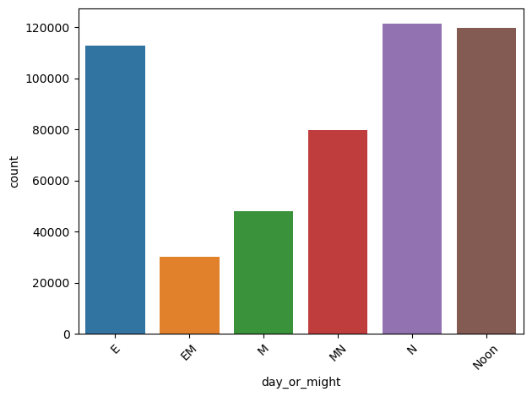
Very less number of customers are active between Midnight to Morning.
Customers are mostly active from Noon to Night
Most Affective time when customers are active is between 7PM to 11PM

Slide 8
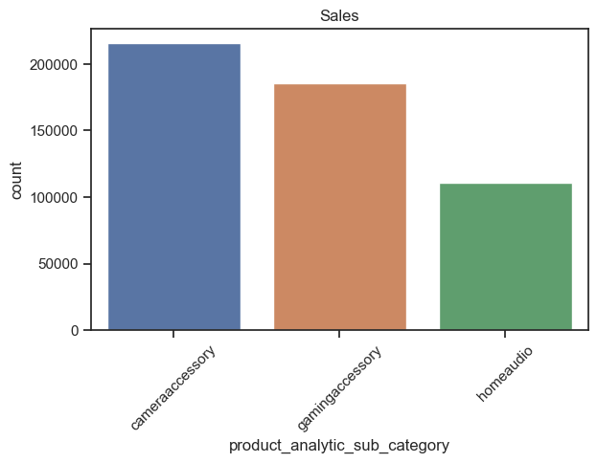
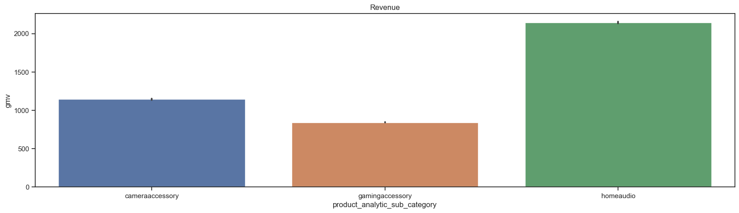
Most Sales are happening for camera Accessory Category
But Surprisingly Home audio category is generating More revenue

Slide 9
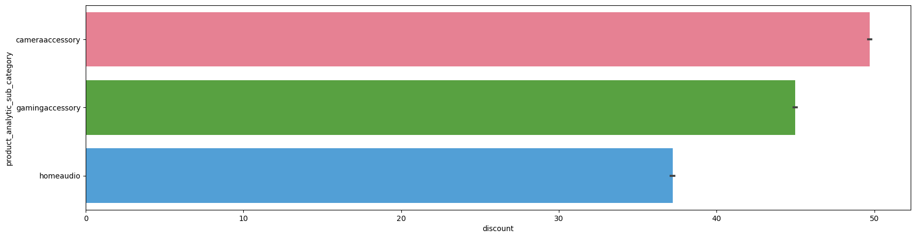
Average Revenue is clearly high for Home audio Category
At the same time it is observed that Average discount is given more on Camera accessory products
Also Sales are on higher side for Camera accessories where discounts are on higher side

Slide 10
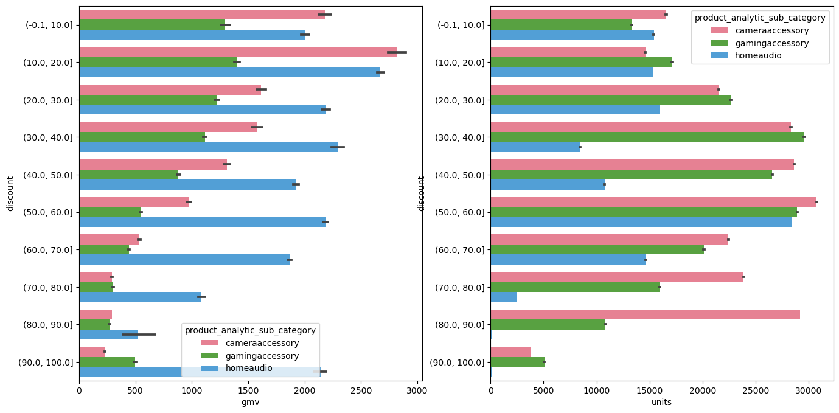
All three categories responds similarly to the Discount as far as revenue is concerned.
Average revenue is more when discount% is around 10% to 20% and it gradually decreases for all three categories
Sales are higher for Camera accesories and Home audio when discount is at 50 to 60 range
For Gaming accessory sales are higher at 30% to 40%

Slide 11
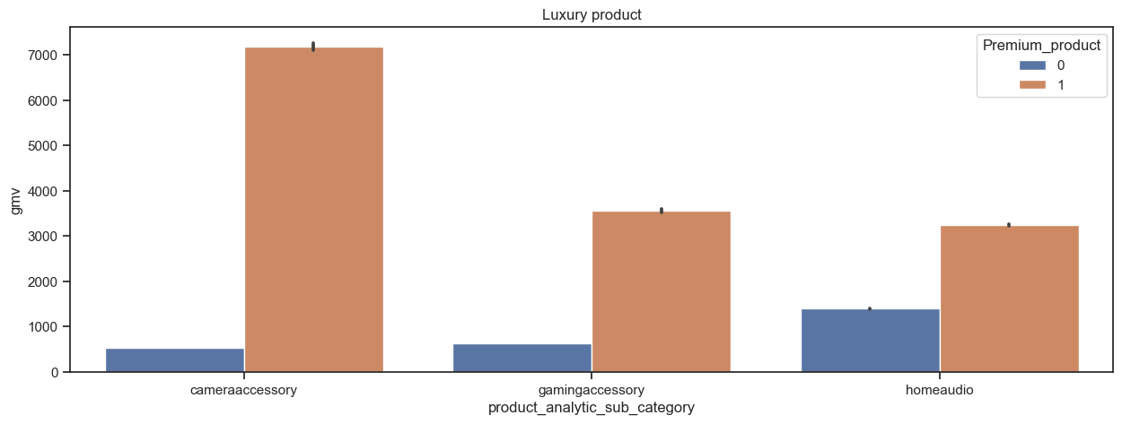
Home audio have higher Premium products compared to other categories
That could be the reason why revenue is more even sales are relatively on lower side
However it can be observed that most number of products being sold are from Mass product category.

Slide 12
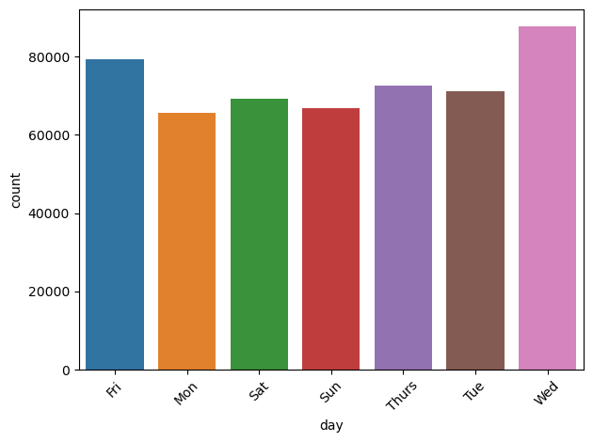
Most customer visits are happening on wednesday and Friday rather than on weekends
This could be alarming as competetors might be very much competitive on weekends with offers.

Slide 13
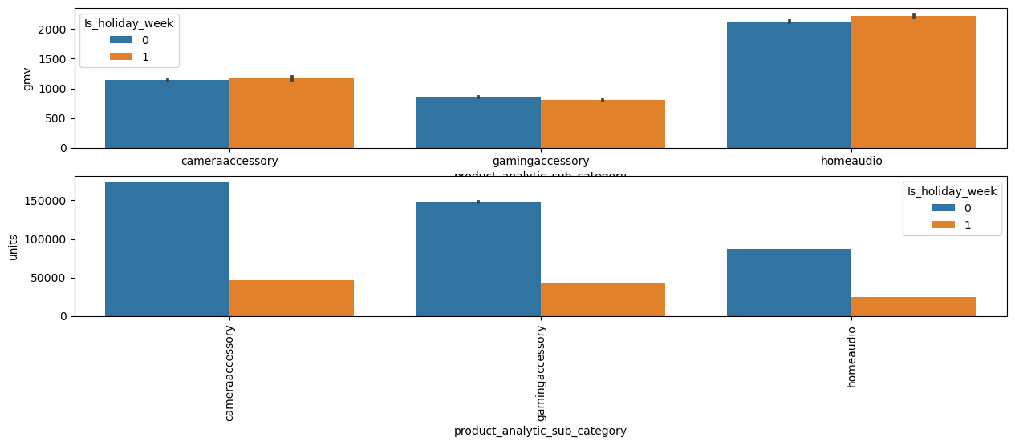
As we have seen in the case of weekdays, even Holidays are not able to contribute much to the revenue
Even when sales are on higher side but that does not shown much impact on revenue
Median of Discount% in Holdays are slighly higher when compared to other days
Even on the Sale days Median of Discouts are higher but Revenues are not increased much

Slide 14
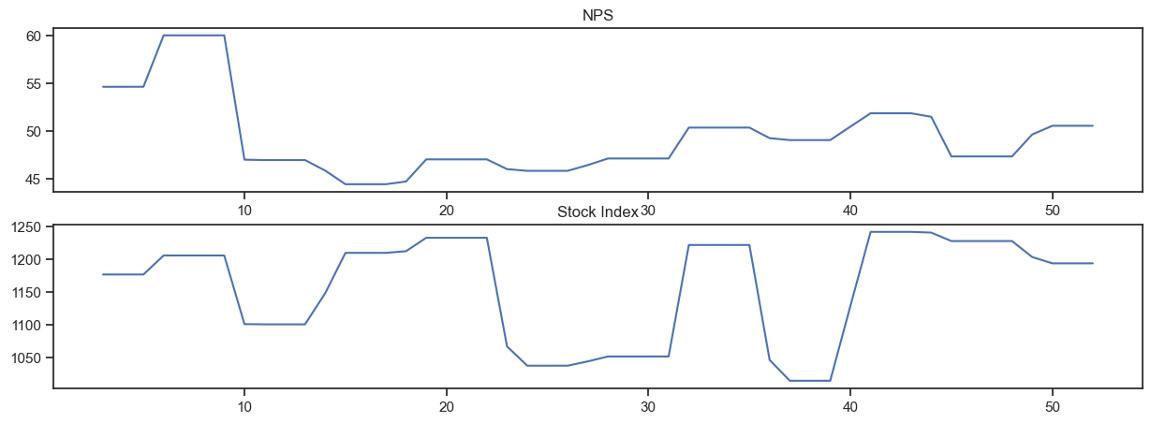
NPS & Stock Index:
Note : Monthly NPS score (this may work as a proxy to the ‘voice of the customer’)
NPS, After Seeing its peek in initial weeks, it drops drastically in week 9 and 10
On the other hand it is observed that Stock index price is volatile and falling drastically when even there is a drop in NPS

Slide 15
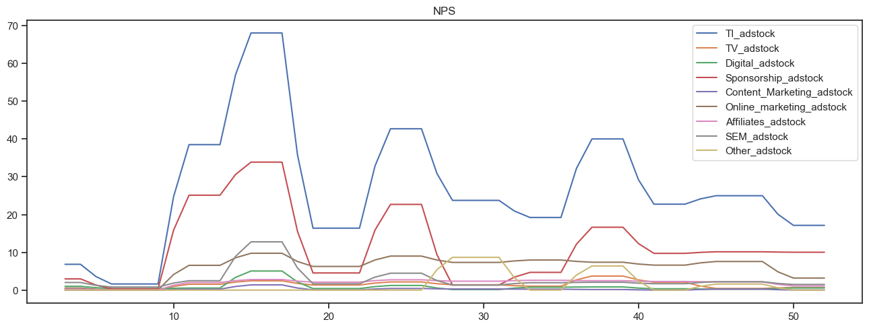
Revenue is responding well to all Media advertisements as we could see steep line for all channels
But Investment on Advertisement seems to be on declined trend can be observed
Sponsorship is the most invested marketing strategy inclined by eleckart

Slide 16
Overview Of Modelling

Slide 17
What is Market Mix Modelling (MMM)?
Half the money I spend on advertising is wasted; the trouble is I don’t know which half.'
-John Wanamaker, Father of modern advertising and a pioneer in marketing.
Market mix modelling (MMM) adds accountability to the spending and decision making in marketing. It uses various types of statistical models to model the relationship between the different categories of spending and their impact on the sales and revenue. Thus, it helps to optimize the marketing spend in the future.

Slide 18
Aggregated the Complete Dataset to weekly level and Segregated the Data to three Categories
Camera accessories
Home audio
Gaming Accessory
Have used Linear Regression Additive Model and Multiplicative Model on all three Datasets to derive the results

Slide 19
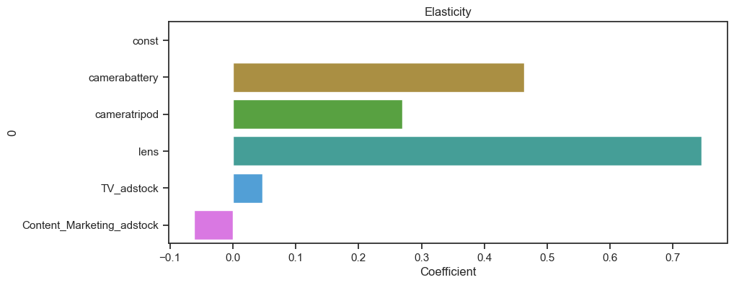
Recommendations– Camera Accessories
Concentrate More on products like camera battery, lens and Camera tripod
These Items yield more revenue
TV is the best advertising Media of all. Invest in the TV advertising and Content marketing can be skipped

Slide 20
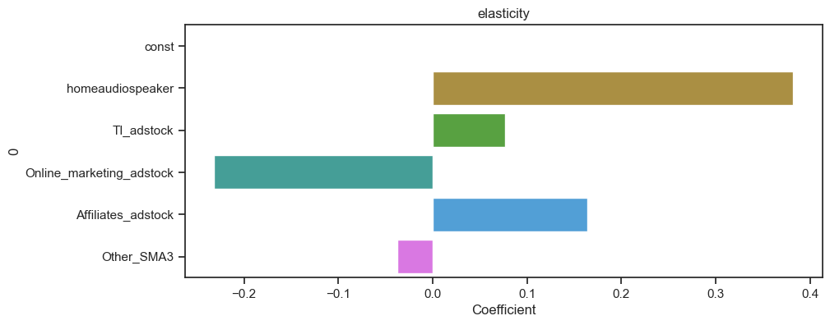
Recommendations – Home audio
* Concentrate more on products home audio speakers
All marketing spends seems give good results except Affiliated
Avoiding affiliate marketing is a good Idea for Home audio

Slide 21
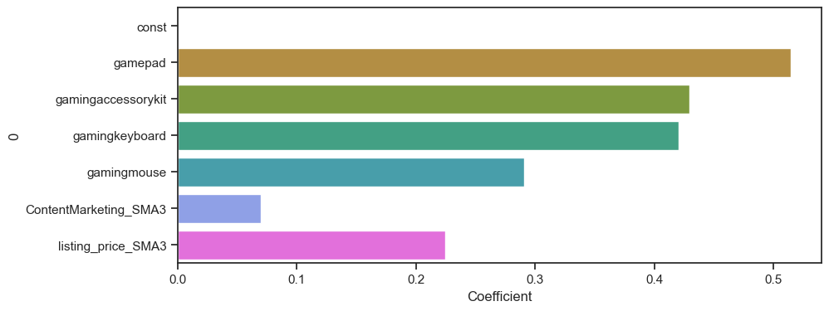
Recommendations – Gaming Accessories
* Concentrate more on products game pad, gaming accessory kit, keyboard and mouse
* Content marketing is the best marketing statergy fpr Home Audio products

Slide 22
Other Recommendations
Advertisements have slight lag affect on sales or revenue. Advertise the content a day or two before Sale day
Weekends are not contributing much to the revenue or sales. It is alarming.
Try to cope up with competitors trend as they might be getting lot of chuck of sales on week days
Advertising may not be affective in order to retain customers on days which are said to be peek seasons or timings
Discount Stratergy has to be good because it needs to operate between good sales and revenue

Slide 23
Thank You

